Slide 1


Powershell: An Introduction
Getting started with the basics
Chris Lovett, MCNC NCET2023

Slide 2


Introduction
Chris Lovett, MCNC
Former PSU (LEA) employee at Edgecombe County Public Schools
First NCET Conference in 2005
Started with MCNC in September 2019
Wrote the “Powersync” set of scripts for Tiber Creek
Member of the Client Network Engineering (CNE) Team @ MCNC

Slide 3


What is an MCNC?
What does M.C.N.C. stand for?
NOTHING…anymore
What did it used to stand for?
Microelectronics Center of North Carolina
We run the NCREN network from which NC PSUs receive their internet
We provide consulting services at no cost to public PSUs across NC

Slide 4
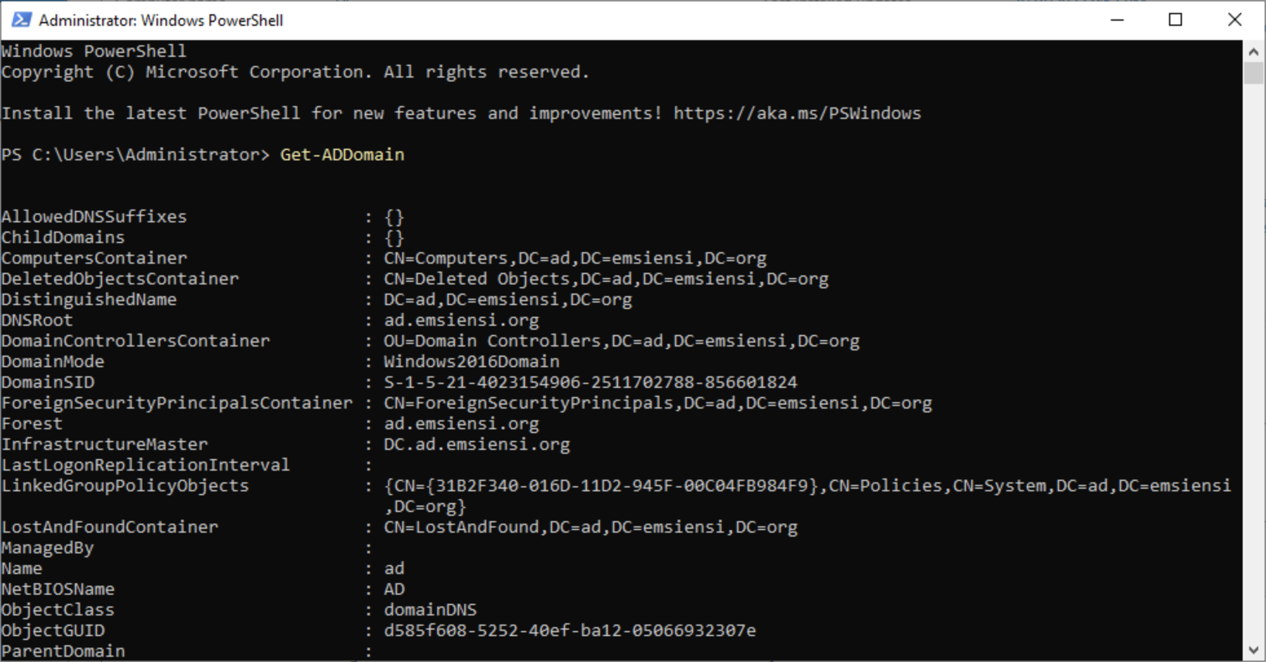
What is Powershell?
A command-line tool, scripting language, and automation platform that helps sysadmins automate recurring tasks
Microsoft’s attempt to make the term “blue screen” a good thing…
Then they gave up and made it a black screen

Slide 5
Powershell commands…
…or cmdlets
Powershell uses cmdlets
Cmdlets consist of a verb, a hyphen (-) and a noun
For example:
Get-Service
Rename-Computer
Get-ADUser
Get-Help

Slide 6
Legacy commands
Legacy or non-powershell commands are still valid
For example:
ping
certutil
netstat
tracert
ipconfig

Slide 7
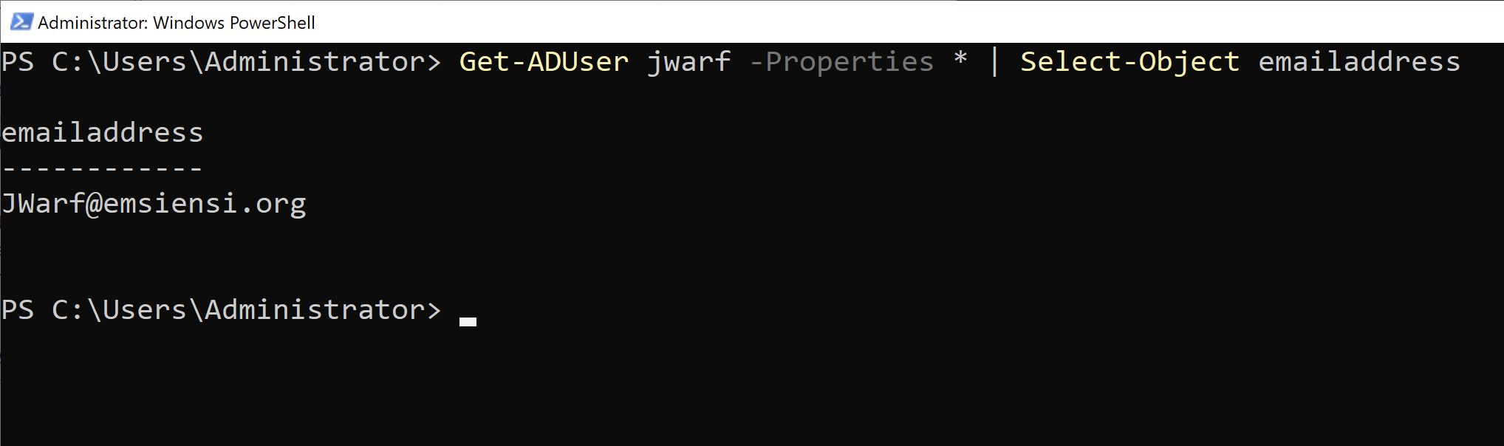
Input and Output
Input and output are typically “objects”
When you run a command like Get-ADUser, the output isn’t a block of text, but rather a series of objects
Such as: samAccountName, objectName, distinguishedName
These objects can be referenced individually
This is extremely useful when piping to other cmdlets

Slide 8
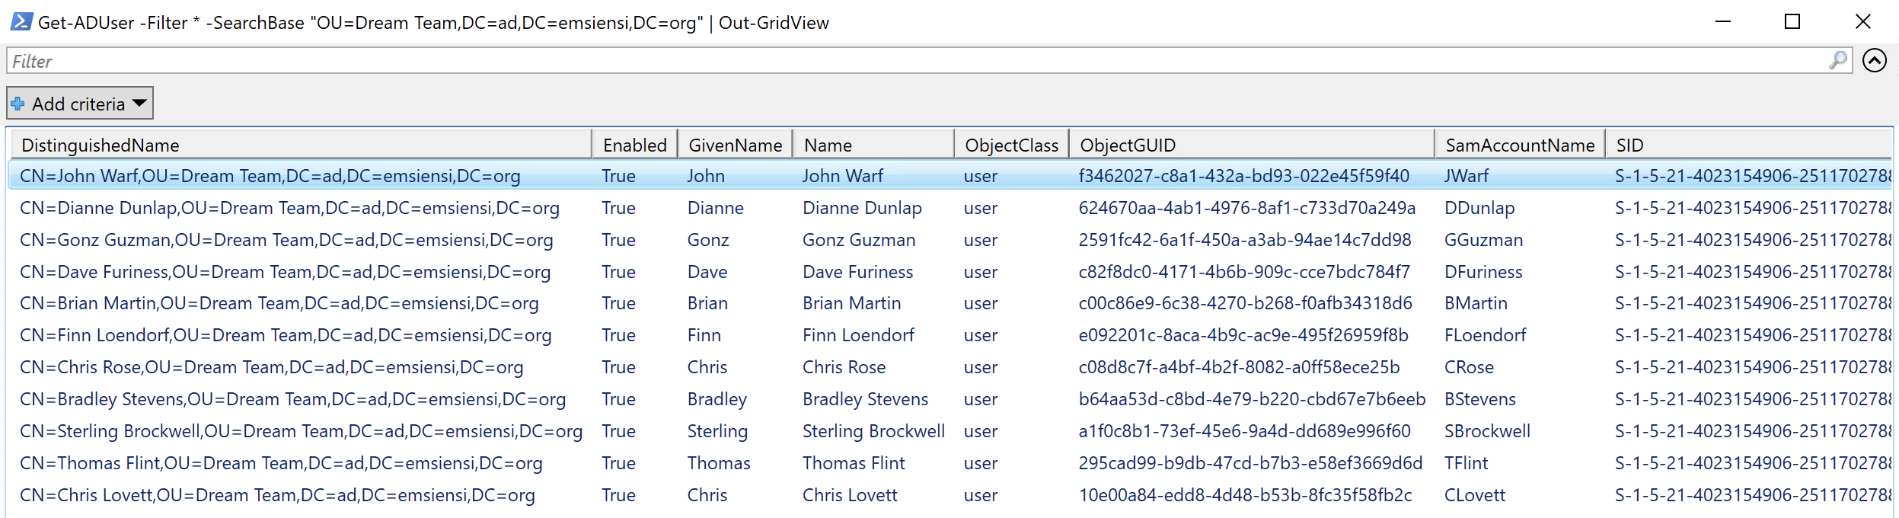
Visualizing Objects
The Out-GridView cmdlet shows the output in a GUI
For example:
Get-ADUser -Filter * -SearchBase “OU=Dream Team,DC=ad,DC=emsiensi,DC=org” | Out-GridView

Slide 9
Powershell Modules
Powershell can be used to manage many things
I mainly use Powershell for managing Active Directory and manipulating data from CSV files.
Other useful modules include DHCP & DNS, among other “RSAT” tools.
There are also modules for managing Azure and Exchange.
You can list the available modules by typing:
Get-Module -ListAvailable
You do NOT have to manually load modules like you did in the “old” days.

Slide 10
Getting Help
If you need help, all you have to do is ask…Powershell
You should run Update-Help at least once
To get help with a command:
Get-Help New-ADUser -Detailed
help New-ADUser -Detailed
man New-ADUser -Detailed
“help” and “man” are aliases for Get-Help. You can view more with Get-Alias.

Slide 11
Enough slides!

